Slide 1
MedFrameQA
A multi-image medical VQA benchmark for clinical reasoning with 2,851 VQA items
Click the link to go to the paper (https://arxiv.org/abs/2505.16964)

Slide 2
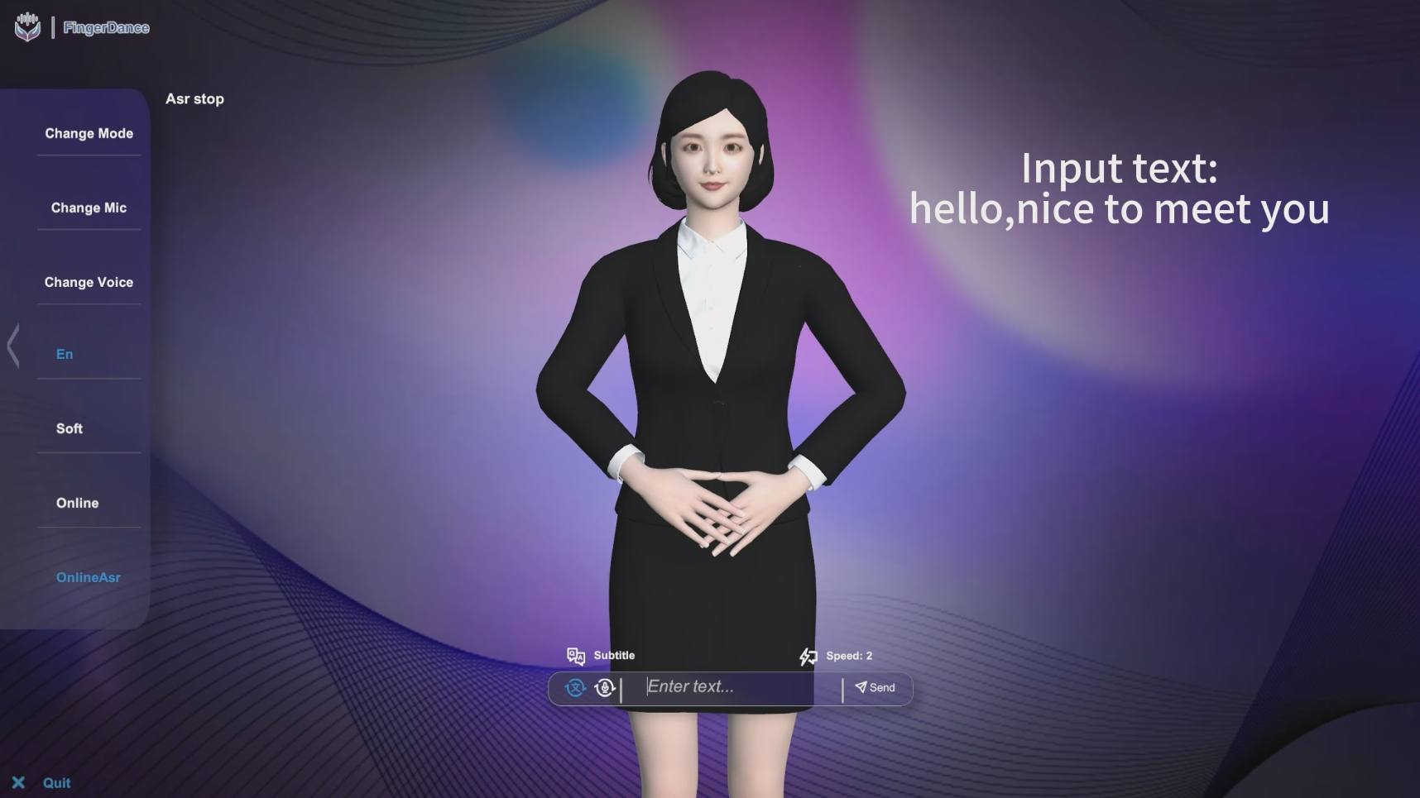
Sign Language Avatar
Function: Translating audio and text into sign language videos
Implementation: Using LLM to reorder the text and combining words into video
Click the image to go to the YouTube video (https://youtu.be/sbASqB8-GnE)

Slide 3
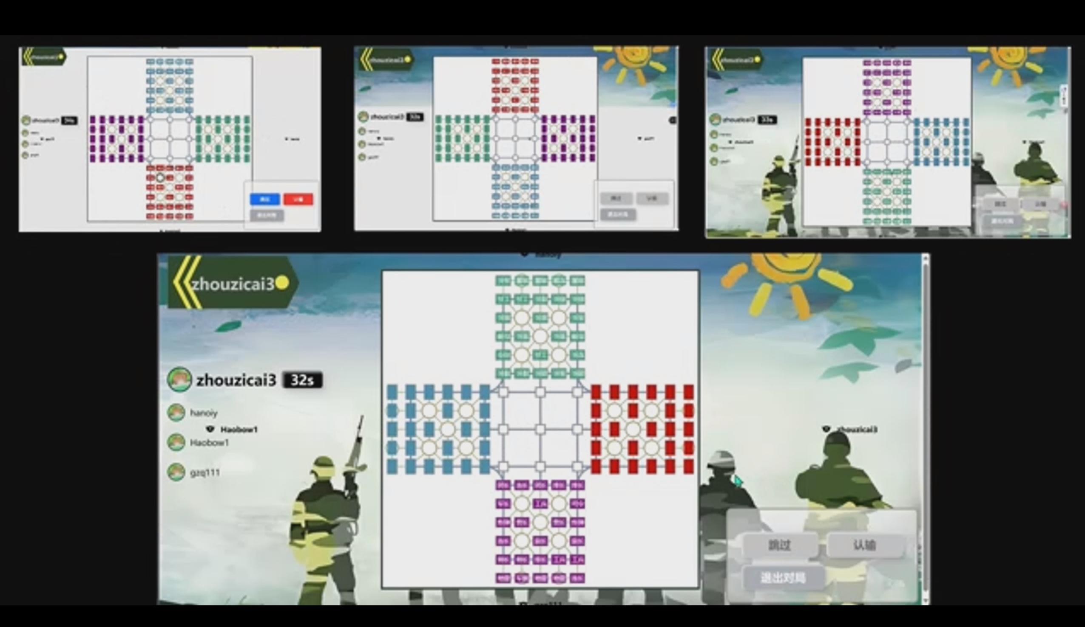
Four Country Military Chess
Function: Four players play chess online
Implementation: Using JavaScript to enforce the game rules, display game interface
Click the image to go to the YouTube video (https://youtu.be/qpswkVIAR0g)

Slide 4
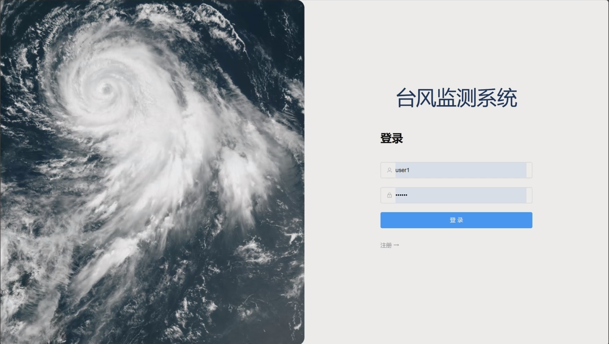
Typhoon monitoring system
Function: Display historical typhoon information and query typhoon in real time
Implementation: Through Vue+Springboot+Mysql to achieve the front and back end
Click the image to go to the YouTube video (https://youtu.be/PAmsHlV8xQ0)

Slide 5
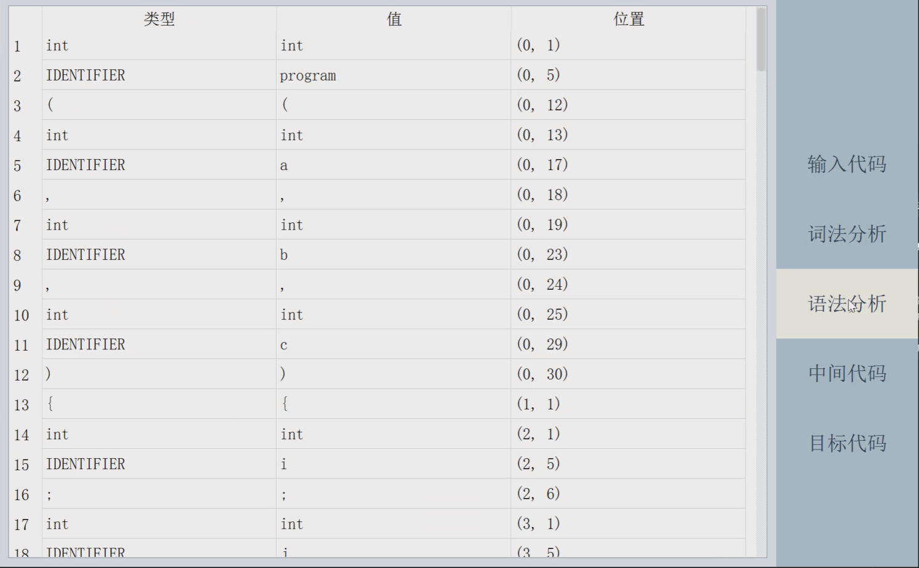
C-like language compiler
Function: A compiler for C-like languages
Implementation: Using Python to implement Lexical analysis and Syntax analysis
Click the image to go to the YouTube video (https://youtu.be/j-0mRrpPSAA)

Slide 6
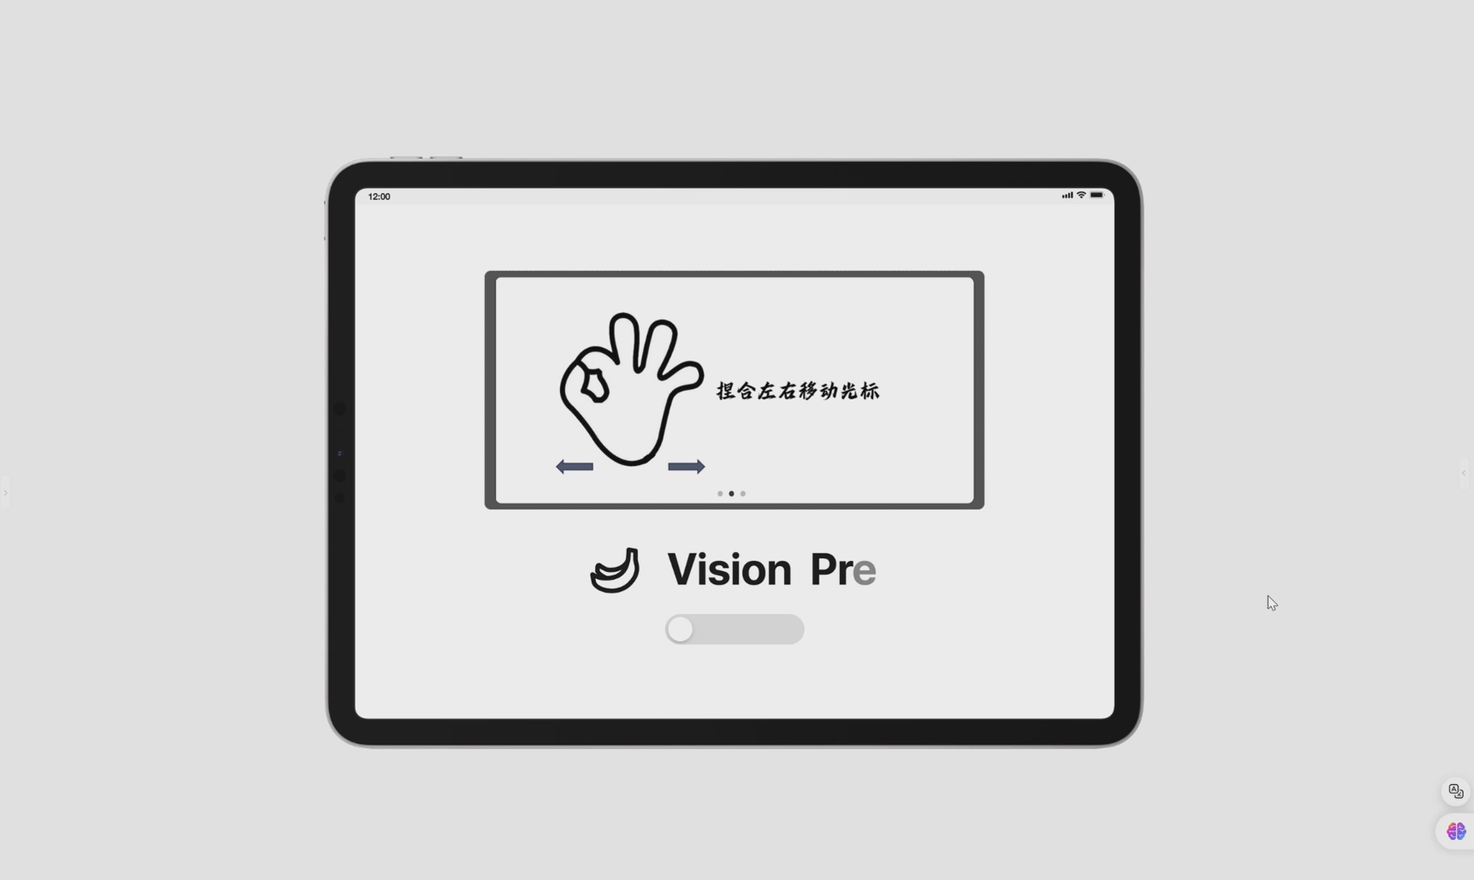
Gesture control system
Function: Using gesture to control operating system
Implementation: Using Python and JavaScript to implement algorithms and layout
Click the image to go to the YouTube video (https://youtu.be/06cWRosGIJM)

Slide 7
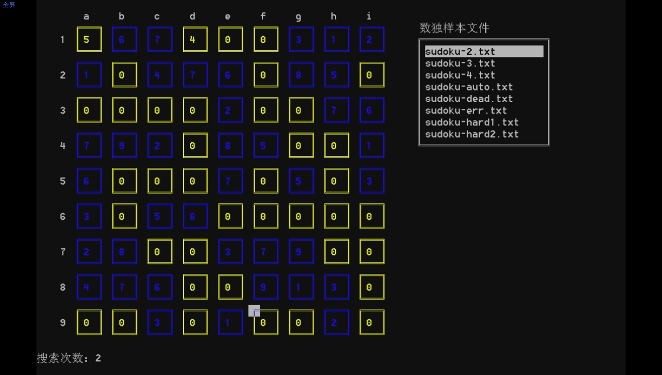
Sudoku
Function: Automatic sudoku solution
Implementation: Using C++ to Display Sudoku interface and design auto solution
Click the image to go to the YouTube video (https://youtu.be/cVn1qhCFmJM)

Slide 8
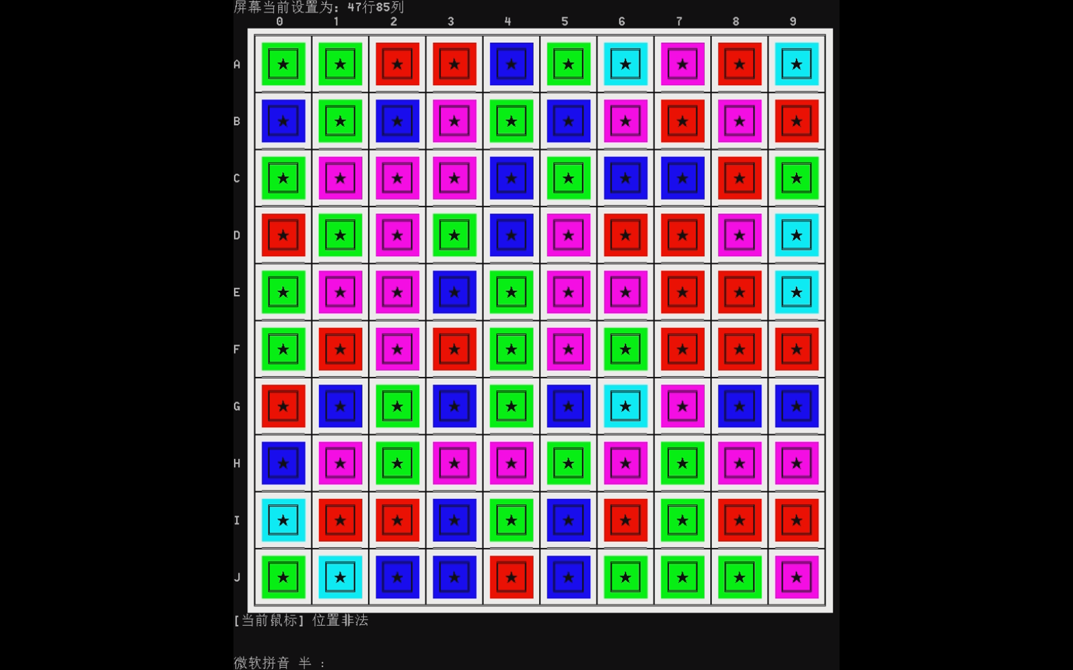
Killing the Stars
Function: The goal of the game is to kill all the stars
Implementation: Using C++ to Display interface and design game rules
Click the image to go to the YouTube video (https://youtube.com/shorts/80frr-D360A)

Slide 9
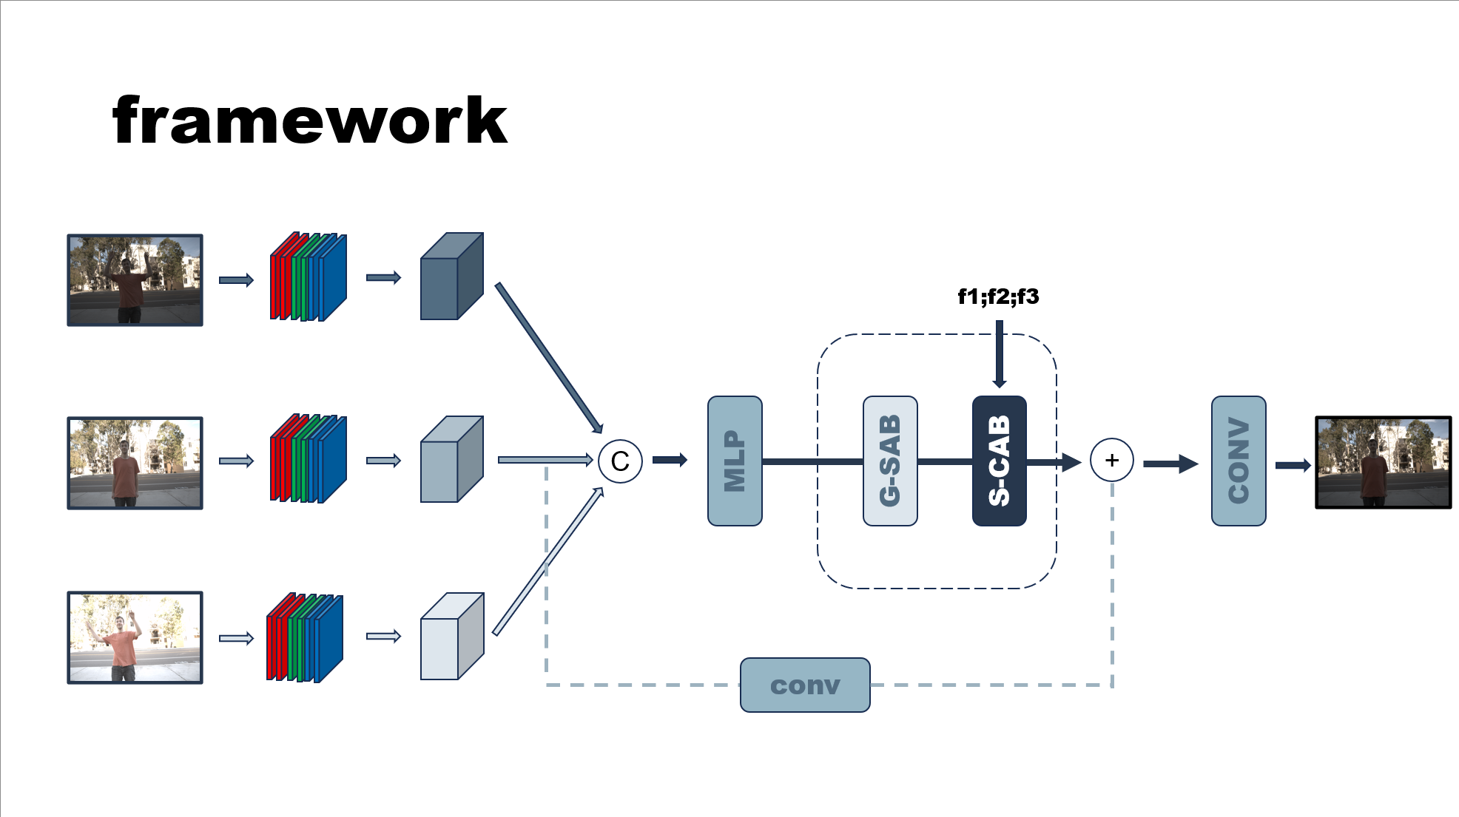
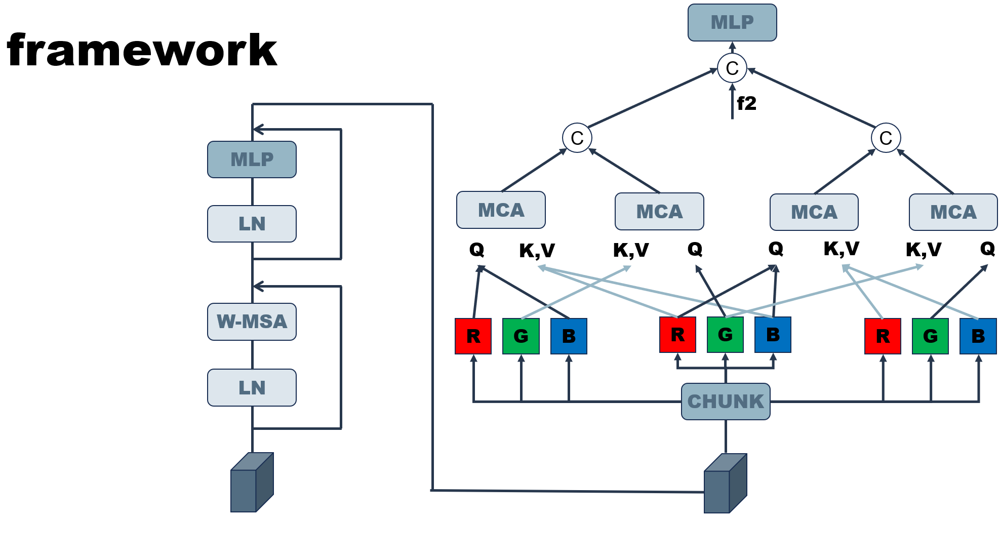
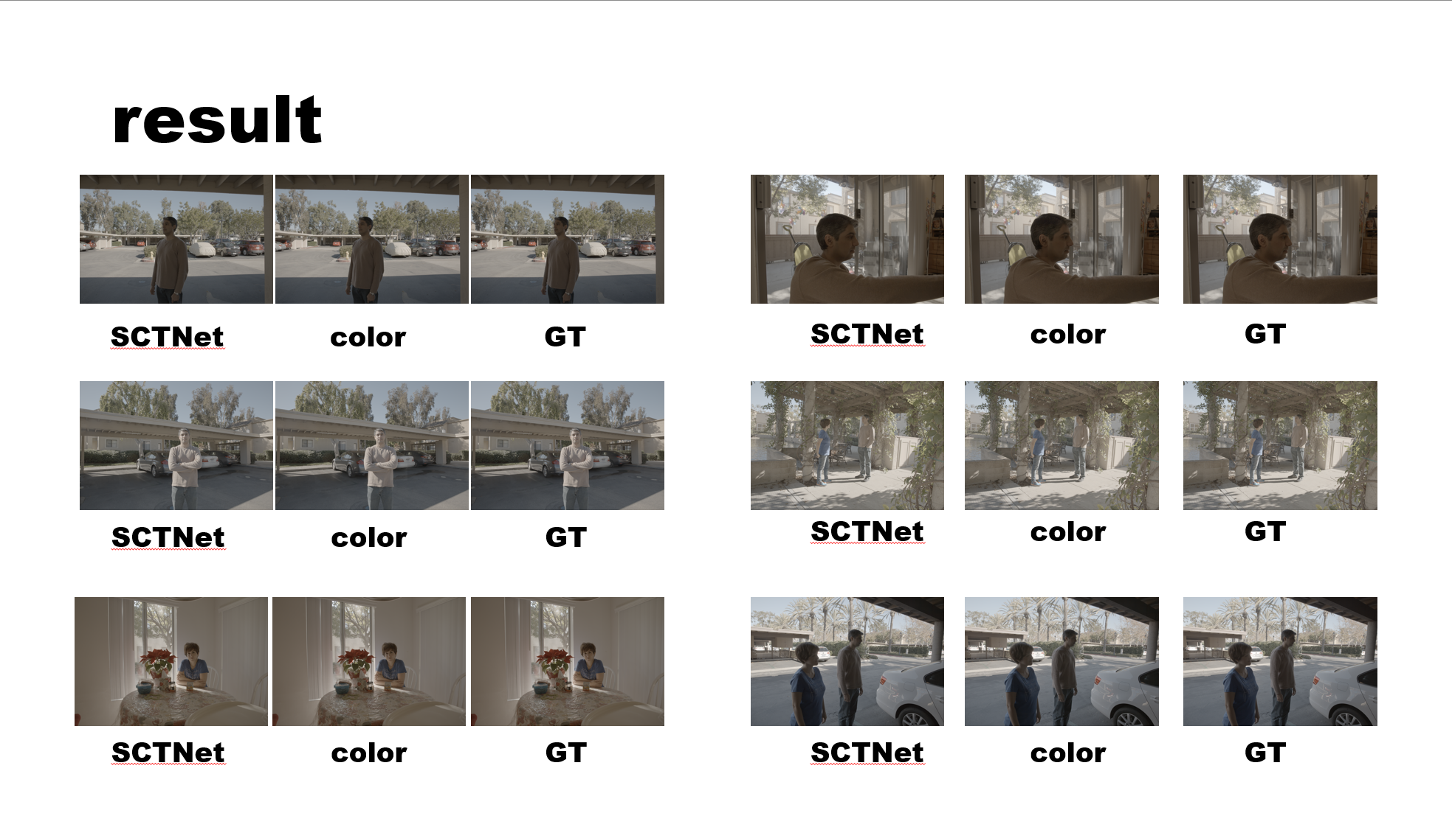
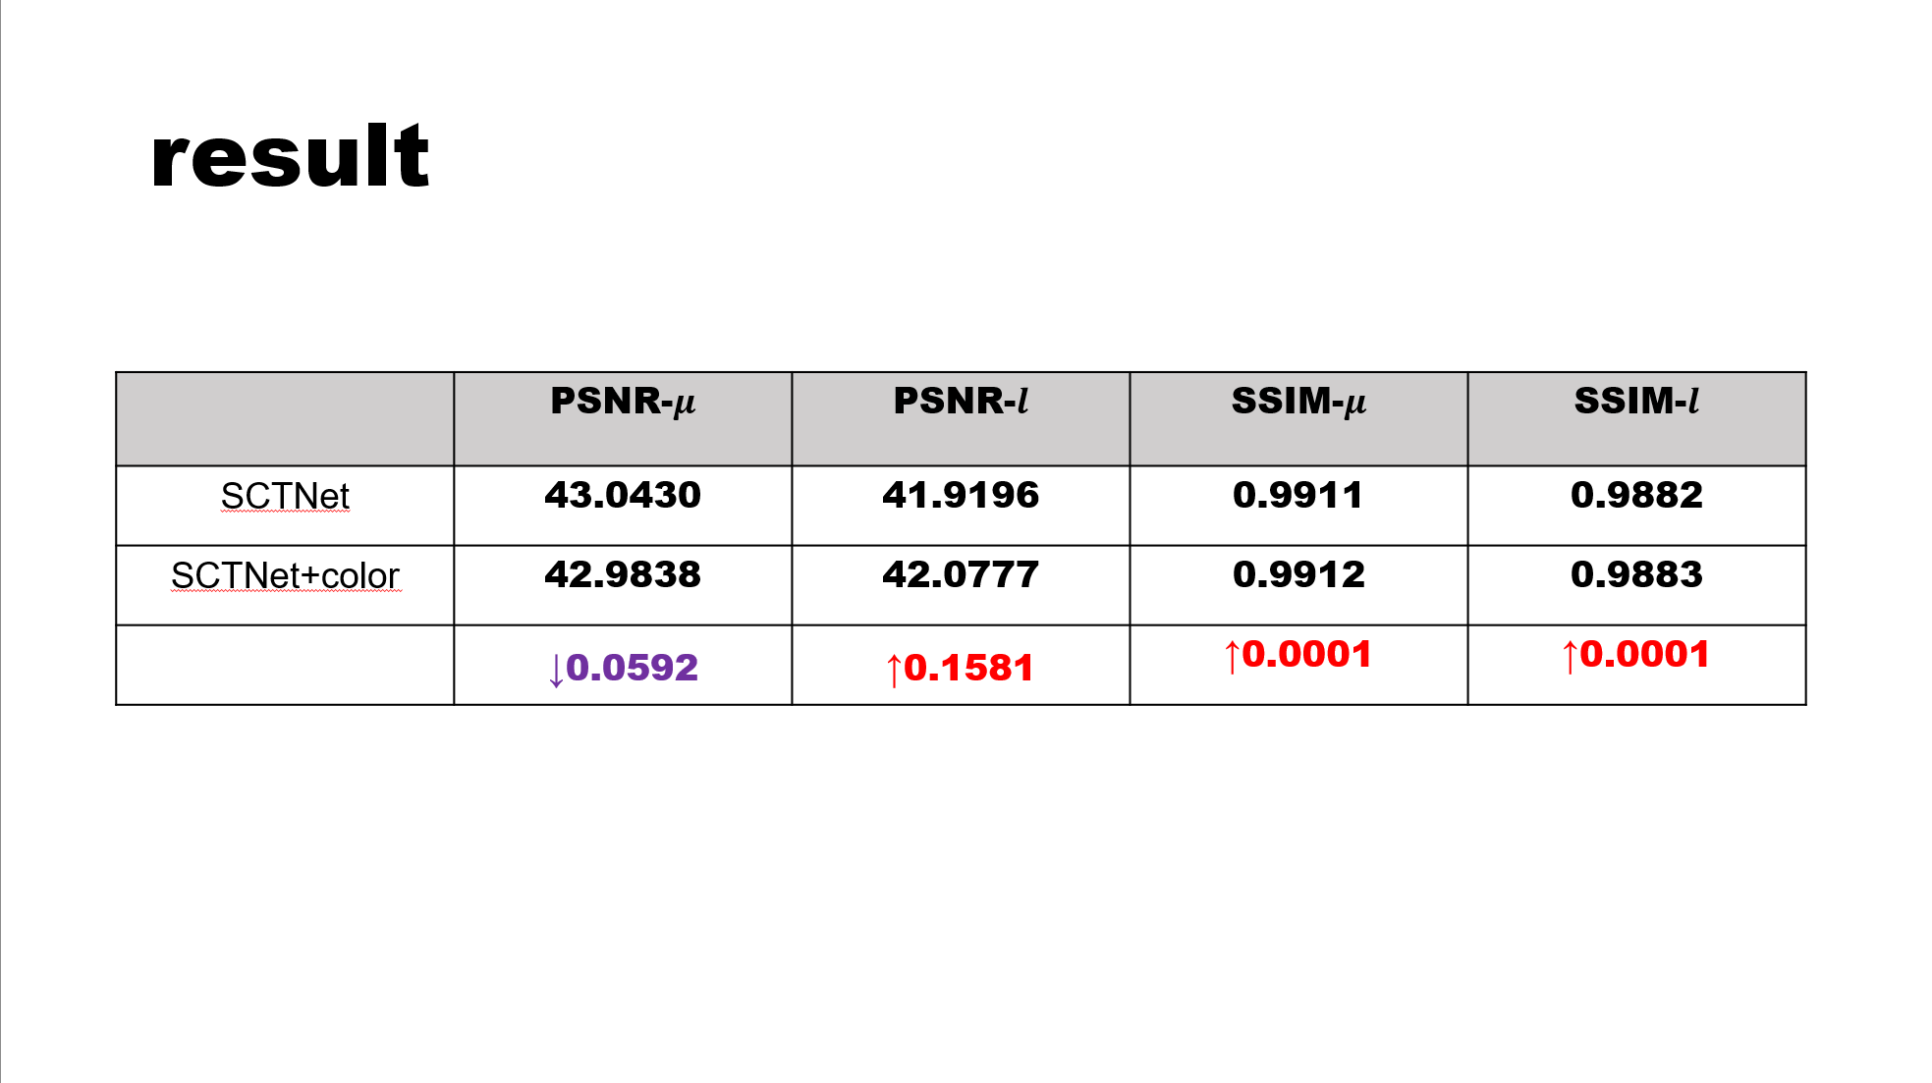
HDR Reconstruction
Function: Using cross-attention framework to improve HDR reconstruction
Implementation: Using Python to implement framework

Slide 10
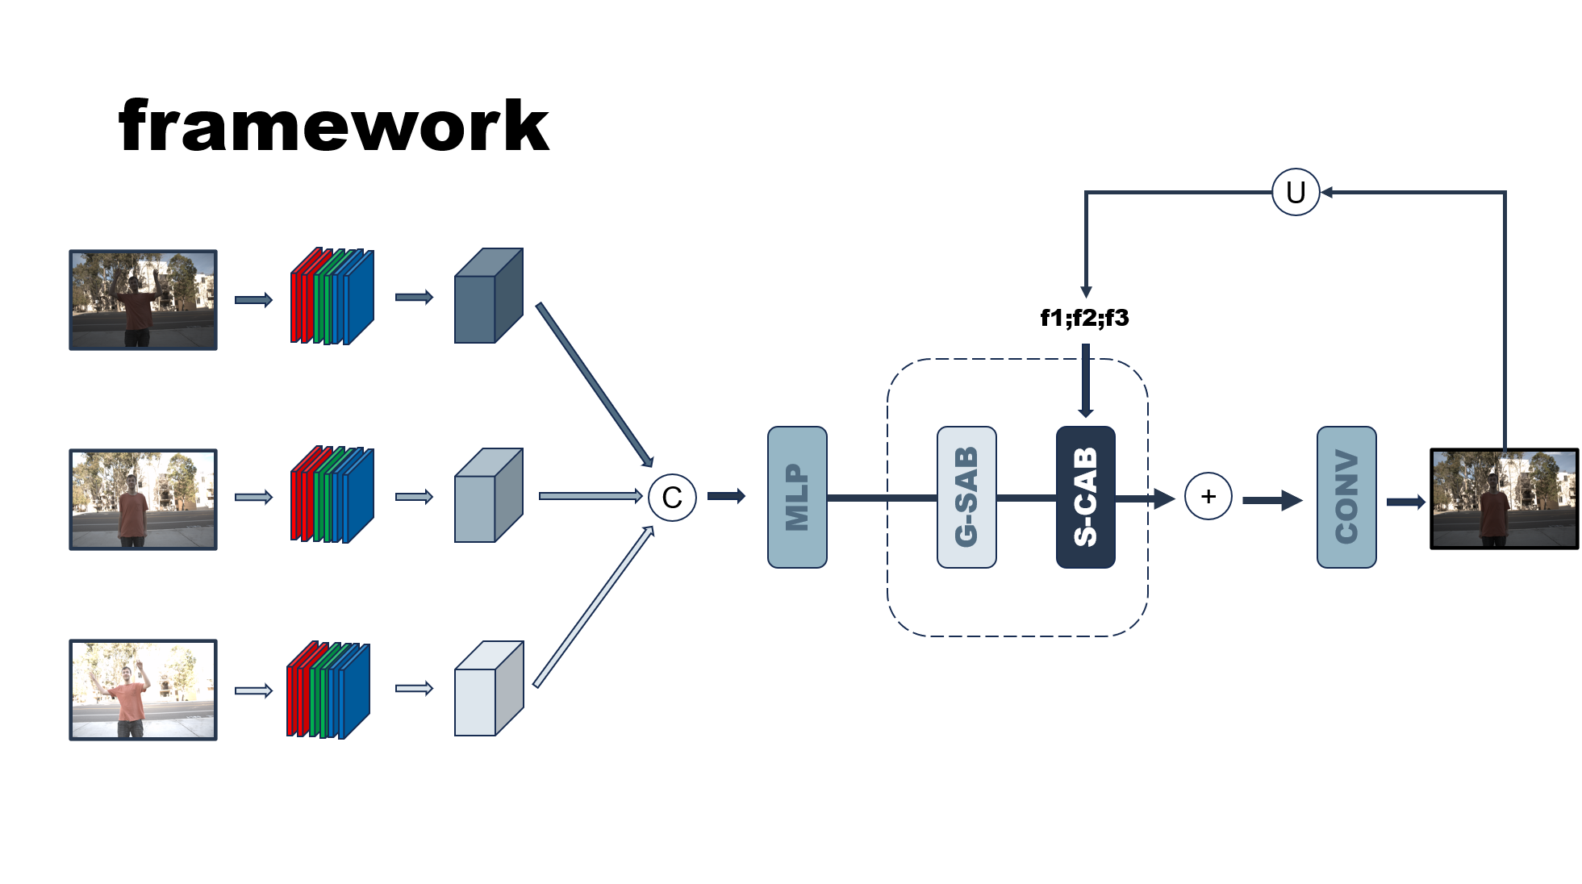
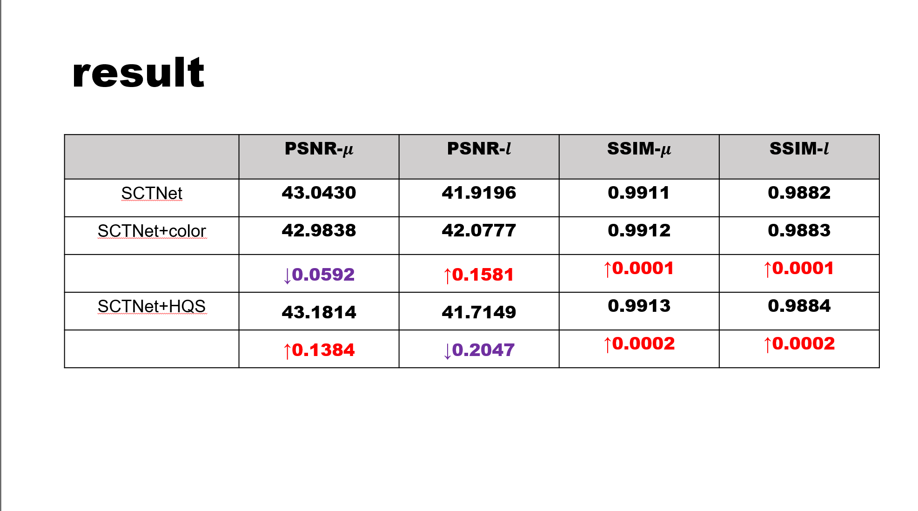
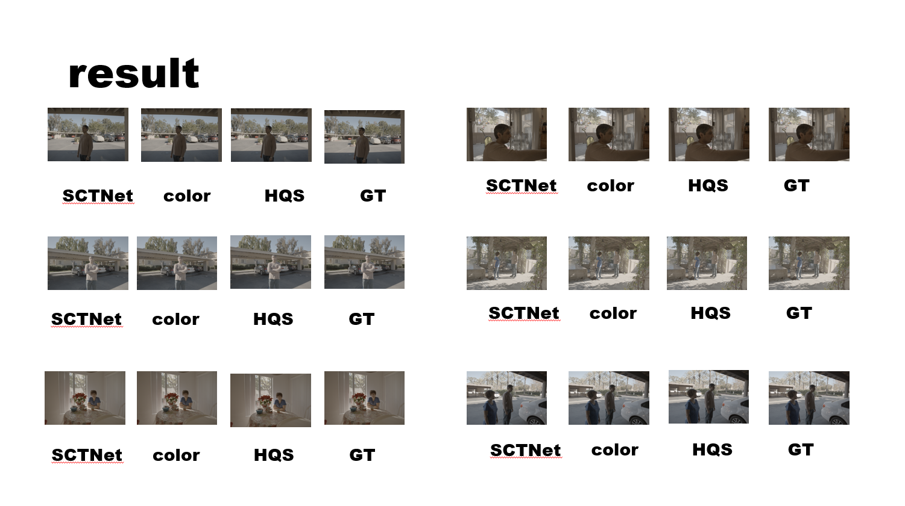
HDR Reconstruction
Function: Using HQS to improve HDR reconstruction
Implementation: Using Python to implement framework

